Slide 1

课时练习
模块五 第二章 第三节

Slide 2
一、翻译下列词组。
1. 像往常一样 ____________________________
2. 习惯于(做)某事 _________________________
3. 害怕做某事 ____________________________
4. 对某人友好 ____________________________
as usual
get/be used to (doing) sth.
be afraid to do sth./of doing sth.
be friendly/kind to sb.

Slide 3
二、用括号内所给单词的适当形式填空， 每空一词。
1. We spent a ________ (love) summer by the sea this year.
2. I can’t get _______ (use) to living in a big city after living in the countryside for years.
3. Meat made from plant protein(蛋白) can be very ________ (help) for our health.
lovely
used
helpful

Slide 4
二、用括号内所给单词的适当形式填空， 每空一词。
4. Shooting stars(流星) disappear very fast, so you must watch the sky _________ (care).
5. I finally _________ (accept) the fact that I would die if I didn’t stop smoking.
carefully
accepted

Slide 5
三、情景交际。
1. 你去医院复查时，医生可能会这样问你的身体状况：
________________________________ today?
2. 你发现要学好英语很难，可以这样向老师倾诉：
I find ________________________________.
How are you feeling
it difficult to learn English well

Slide 6
三、情景交际。
3. 你想知道对方是否愿意做你的朋友，可以这样问：
Would you ___________________________?
like to become/be my friend

Slide 7
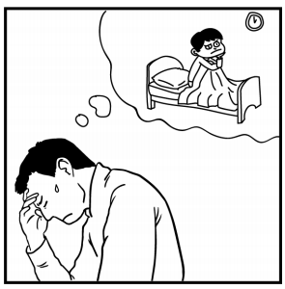
四、看图写话。
1. tired, because
The man/He is tired because he didn’t sleep well.

Slide 8
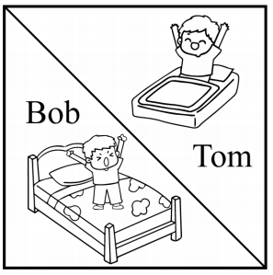
四、看图写话。
2. early, as … as
Bob gets up as early as Tom.

Slide 9

四、看图写话。
3. hair, not, so
Helen’s hair is not so long as Lucy’s.

Slide 10
五、熟词生义。
1. accept A. vt. 接受(建议、邀请等) B. vt. 接纳，接受(为成员) C. vt. 承担；承认
_____ (1) You have to accept the consequence(后果) of your act.
_____ (2) She was disappointed not to be accepted into the club.
_____ (3) Please accept my sincere apology(道歉).
C
B
A

Slide 11
五、熟词生义。
2. fail A. vt. 使不及格；没通过 B. vi. 失败；未能(做到) C. vi. 不足，短缺 D. vi. 衰退，衰弱
_____ (1) His sight(视力) is beginning to fail.
_____ (2) The car failed to climb the hill.
_____ (3) The water supply(供应) failed.
_____ (4) Jim was sad because he failed the English exam.
D
B
C
A

Slide 12


